Slide 1
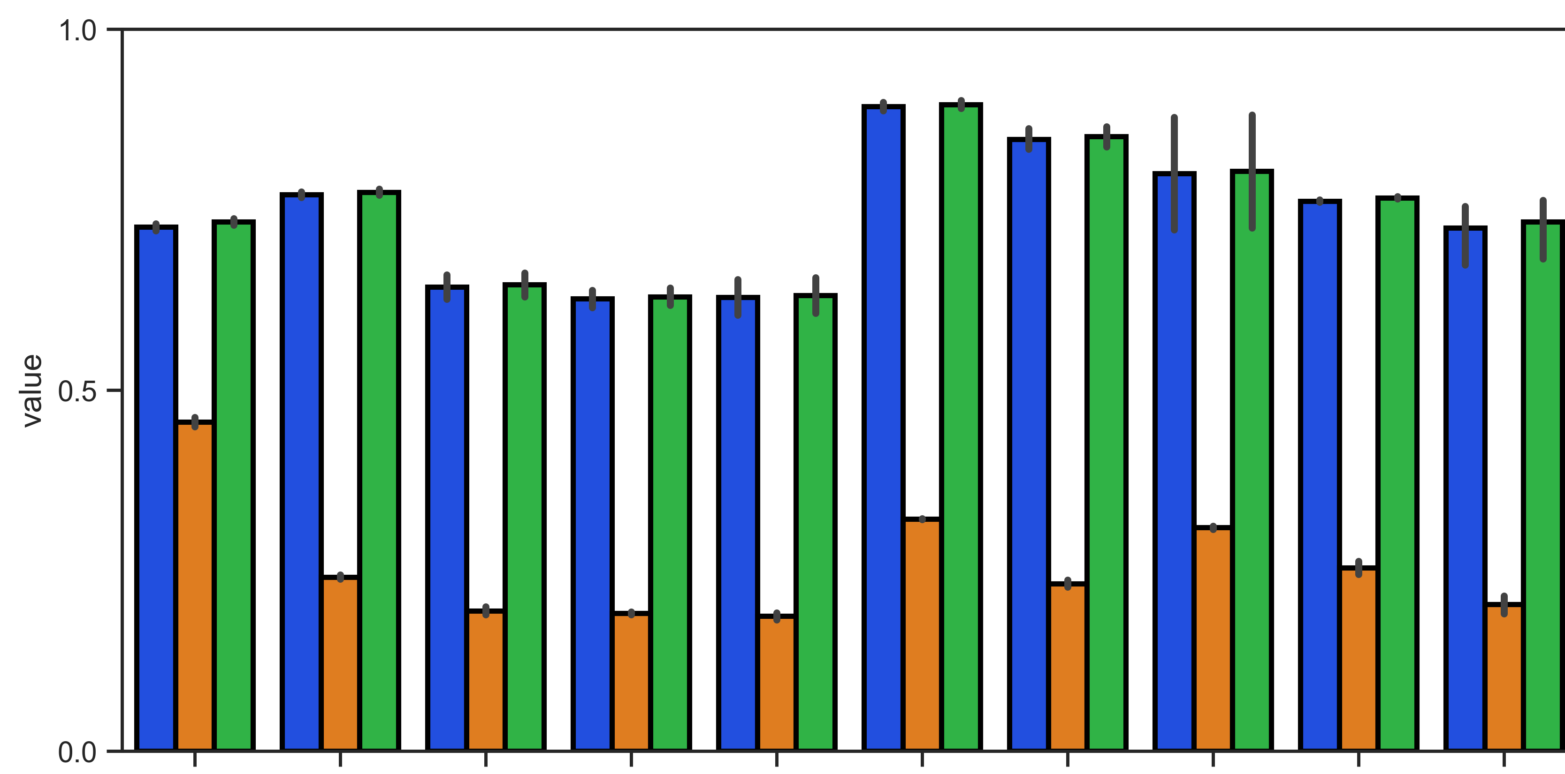
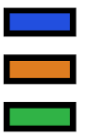
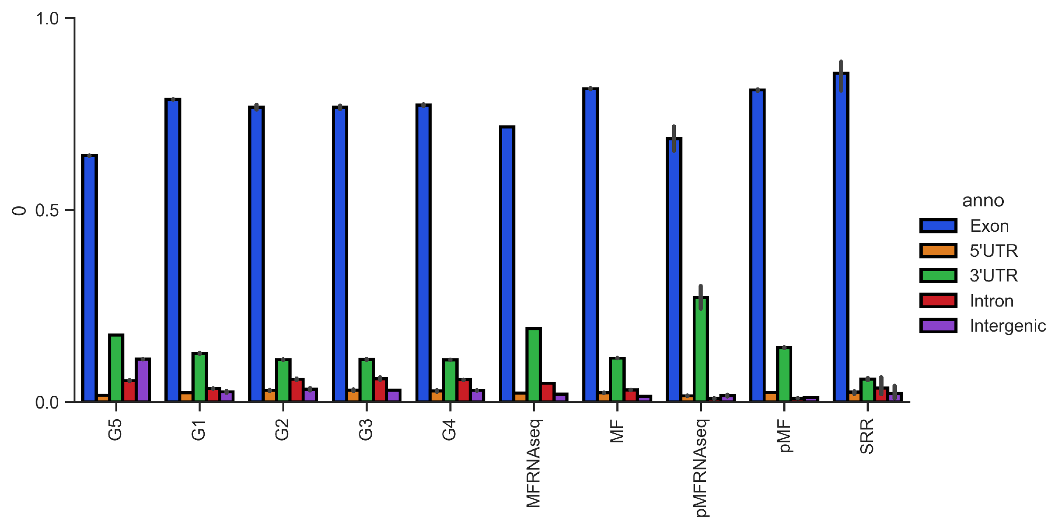
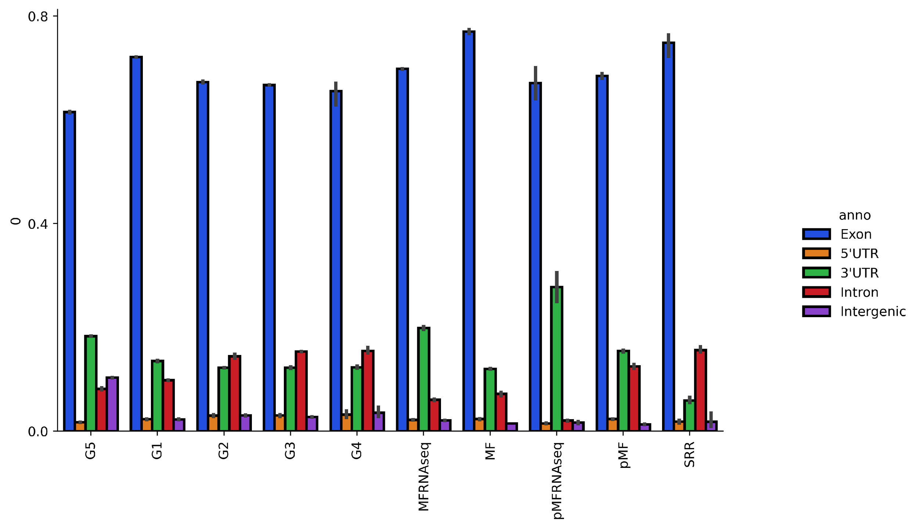
A
meRanGh
meRanT
meRanGh + meRanT
MT RNAseq
MT-A
MT-B
MT-C
MT-D
Total RNAseq
Poly RNAseq
Huang
B
Total RNA BS-seq
Poly RNA BS-seq
Annotation Distribution
MT RNAseq
MT-A
MT-B
MT-C
MT-D
Total RNAseq
Poly RNAseq
Huang
Total RNA BS-seq
Poly RNA BS-seq
Notes:
(A) Mapping rate of libraries using meRanGh (genome) and meRanT (transcriptome). Hybrid mapped reads were created by piping multi-mapped and unmapped reads to the unused mapping protocol (ie meRanGh multi-mapped and unmapped reads were used as input to meRanT to create aggregate Genome-mapped reads). Only uniquely mapped reads are reported. (B) Mapped transcripts were annotated using RSeQC [33] and RefSeq mm10 annotations.

